Slide 1
Beauty and the Beholder: Exploring the Impact of Attractiveness Perception on Second Date Success
Dataset: Speed Dating
Waves of diverse dates
Central Attributes: Attractiveness, Intelligence, Sincerity, Fun, Ambition
Participants allocate 100 points across these attributes
Participants rate themselves on these attributes on a scale of 1 - 10
After each date, ratings given on a scale of 1 - 10
Decision for a second date
Successful matches identified
Key Research Questions:
Which attribute drives second date potential?
Is confidence alone enough for success?
The role of accurate self-perception in attraction

Slide 2
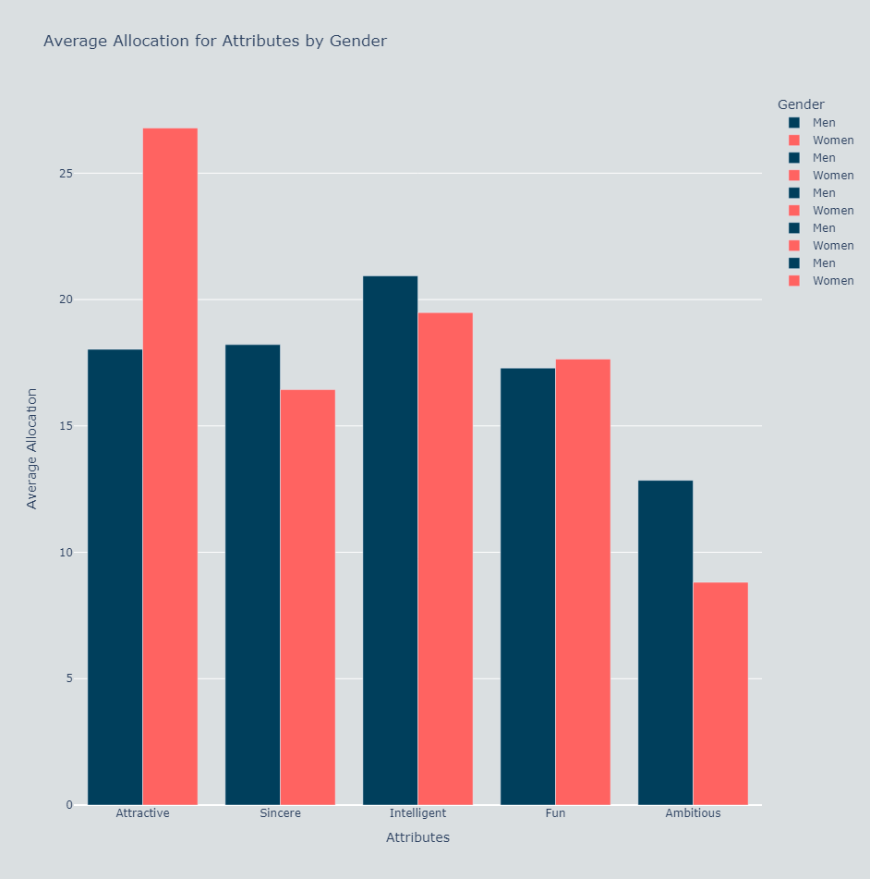
Unveiling the Mismatch: Initial Preferences versus Real-World Dynamics
Women prioritize attractiveness
Men place higher importance on intelligence
Sincerity, intelligence and fun hold similar significance
Ambition least influential

Slide 3
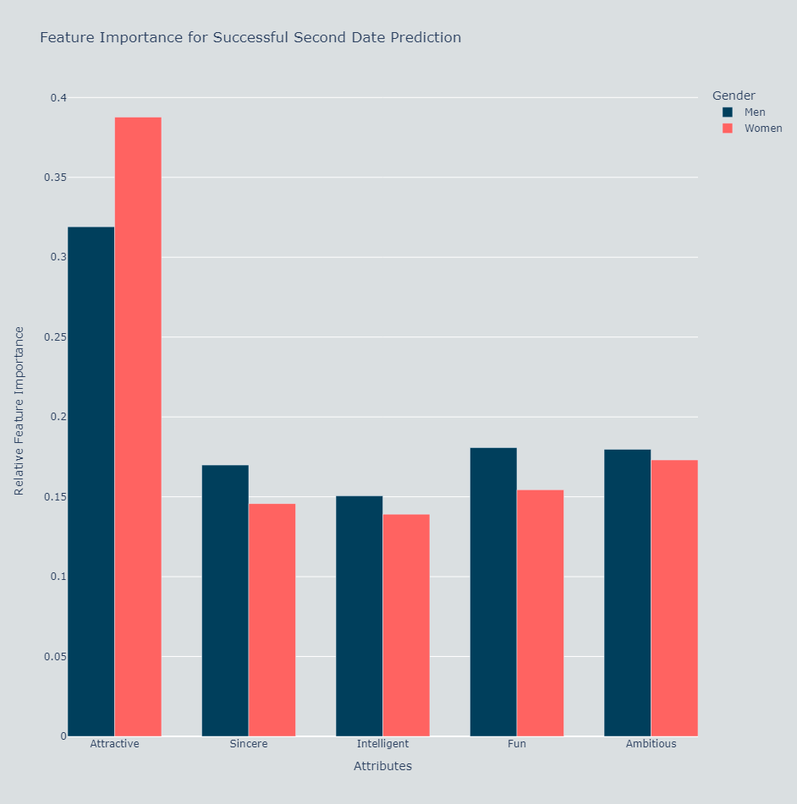
Unveiling the Mismatch: Initial Preferences versus Real-World Dynamics
Random Forest: 79% accuracy
In reality, attractiveness outweighs all other attributes
Observe the interplay between perceived preferences, societal influences and unpredictable nature of human connections

Slide 4
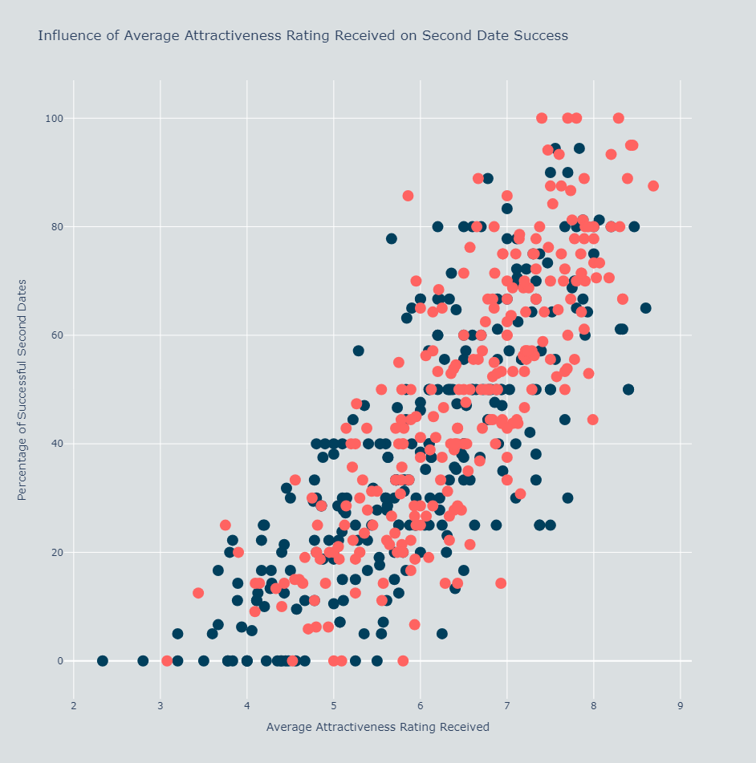
The Power of Attractiveness: Unveiling the Link between Attractiveness Ratings and Second Date Success
Compelling correlation between high attractiveness rating and second date success
A rating of 5.5 - 6.5 exhibited 50% success
Lower attractiveness ratings predominantly men
Higher attractiveness ratings primarily women
Highlights importance of attractiveness
Is second date success based solely on the attractiveness rating you receive?

Slide 5
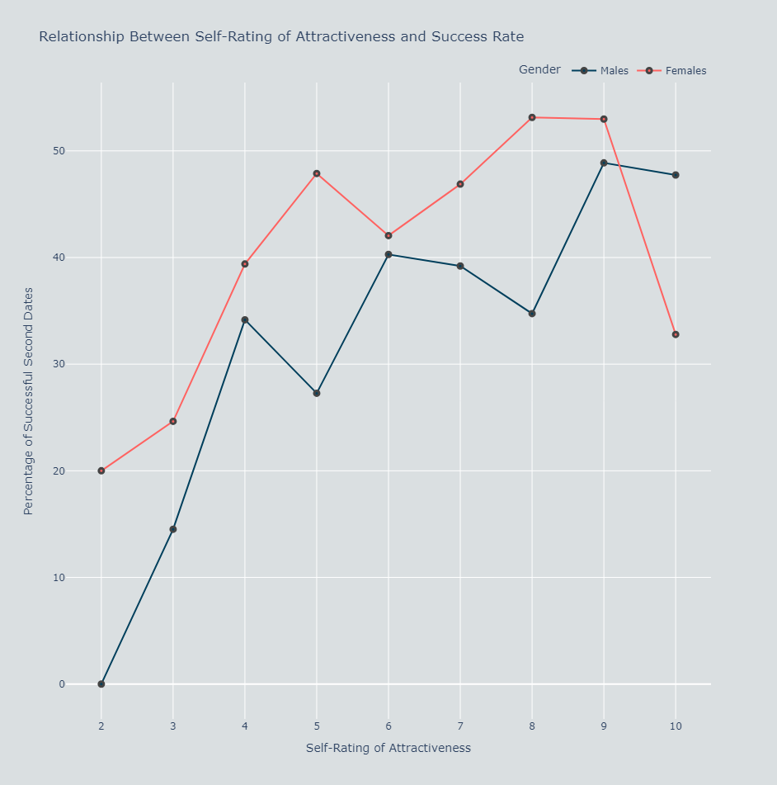
Exploring the Impact of Self-Rated Attractiveness on Second Date Success
Percentage calculated by considering all people with a particular value
General upwards trend particularly 2 - 4 but fluctuations
Women tend to have higher success percentage compared to men
From this it would seem confidence does play a role in speed dating success

Slide 6
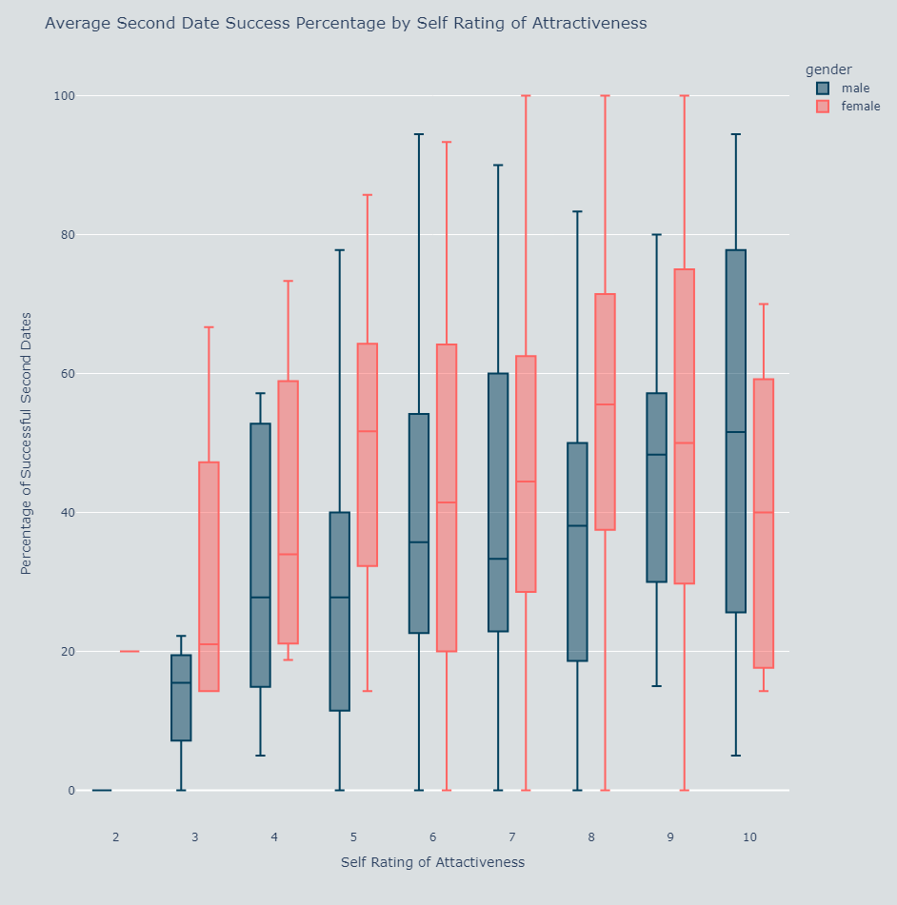
Exploring the Impact of Self-Rated Attractiveness on Second Date Success
Percentage calculated per individual
Slight upwards trend in the mean
Substantial variation
For men, the lower quartile is larger for 6 than 8
Relationship between confidence and second date success is complex
Could it be less about confidence but more about accurate perception?

Slide 7
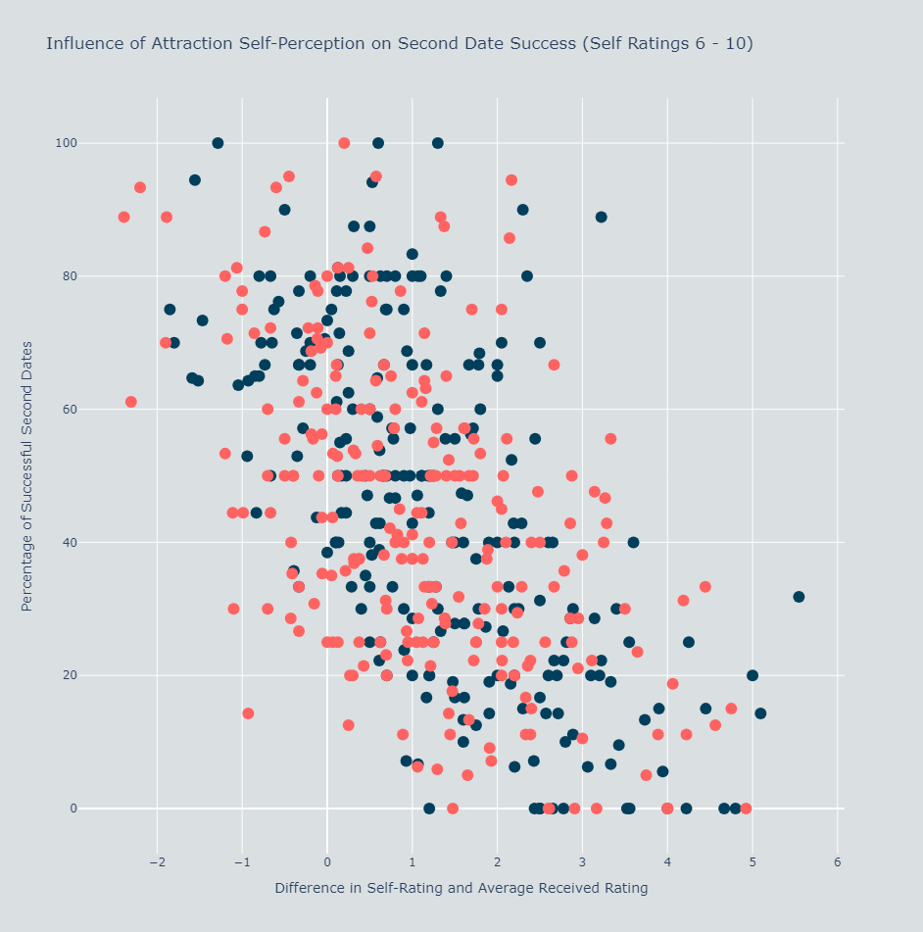
Exploring the Impact of Self-Perceived Attractiveness on Second Date Success
Majority rate themselves above statistical average
For people who rated their own attractiveness 6 - 10
General downward trend
Smaller difference between genders for self-perception

Slide 8
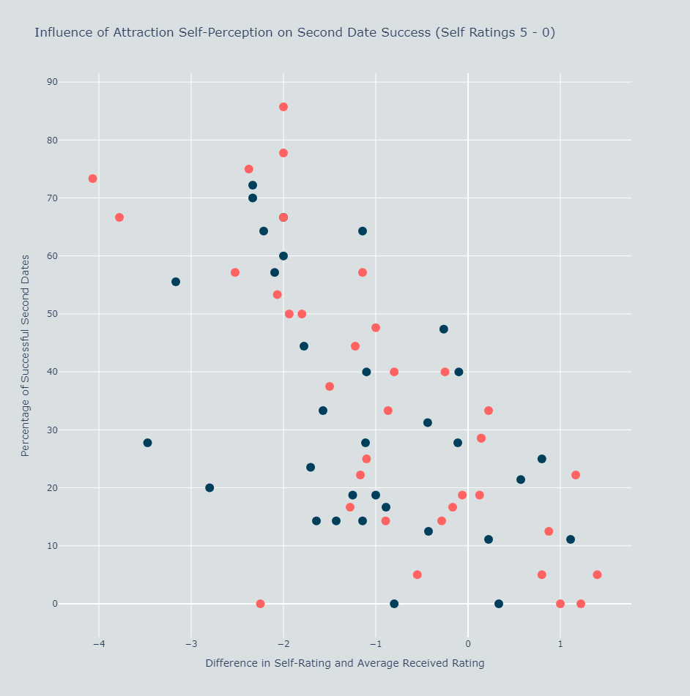
Exploring the Impact of Self-Perceived Attractiveness on Second Date Success
Similar downwards trend
‘Left-shifted’ version of previous graph
For the same success percentage, a person less confident in their attraction, has to underestimate more

Slide 9
Summary
We see that attraction was one of the most crucial factors in second date success
Confidence in your own attraction played a key role
However, there’s more to confidence than meets the eye.
Accurate estimation of attraction with high confidence led to the highest likelihood of success.
A lower self rating would require more underestimation
It seems a combination of actually being attractive and being confident but accurate in your attractiveness is the key
But…

Slide 10
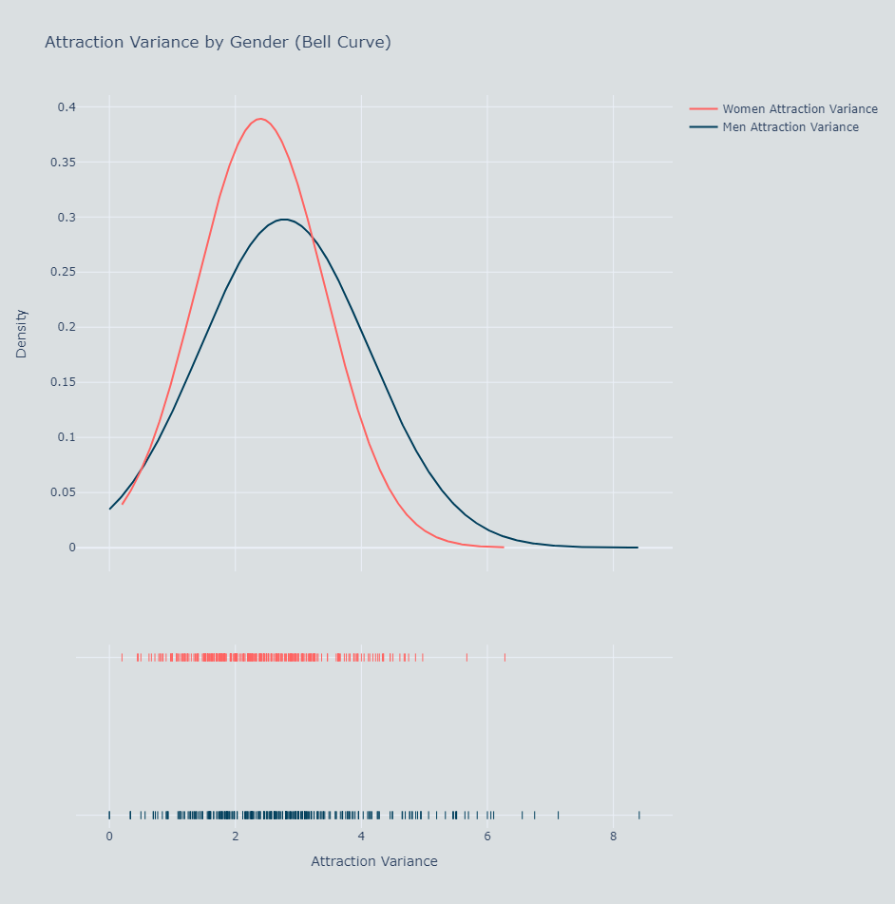
Beauty is in the Eye of the Beholder
Attractiveness is subjective
We see a large variance per person in attractiveness ratings
We can see attraction is important but we cannot define what attractive is objectively

Slide 11
Further Work
There are other fields for exploration
Additional factors like where they’re from, their age, their income, their career etc. could also play a role in second date success
This would however require a separate study
It would be important to capture the relationships between these additional factors and second date success
And the relationships between these additional factors and attraction

